Slide 1

CROP DISEASE DETECTION SYSTEM
-Mr. NILESH THORAT SIR

Slide 2
GROUP MEMBERS:-
Gayatri Shivaji Mali 3024
Vaishnavi Vijaykumar Sanade 3038
Priyanka Raju Mohole 3051
Rutuja Rohit Sangar 3044

Slide 3
PROBLEM STATEMENT:-
Farmers often find it difficult to identify plant diseases at an early stage. Many diseases look similar, and not all farmers have expert knowledge to recognize them correctly. Checking plants manually takes a lot of time and can lead to mistakes. If the disease is not detected early, it can cause serious damage to crops and reduce yield.

Slide 4
OBJECTIVE:-
To detect plant diseases using leaf images.
To develop a scalable architecture that allows easy addition of new crops and diseases in the feature.
To develop user friendly application interface enabling farmers to upload images to receive instant and future diagnosis results.
To suggest treatment and prevention suggestions.
To develop a cost-effective AI solution that reduses reliance on manual inspection and expert intervention .

Slide 5
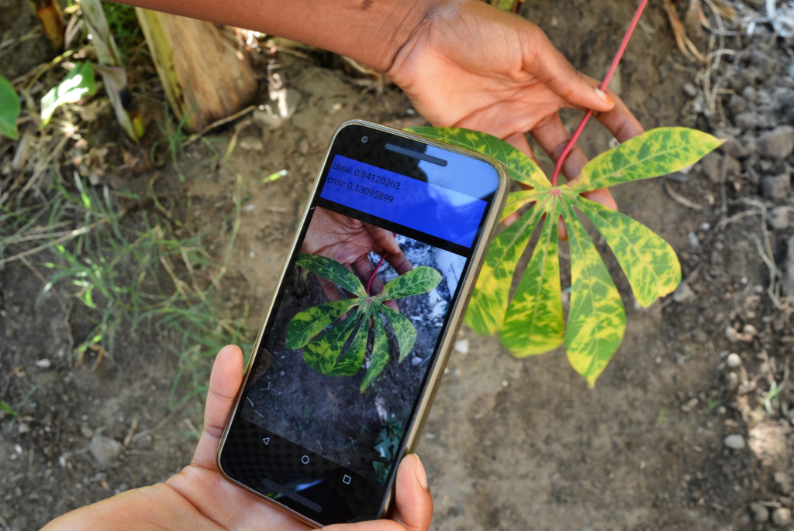
Proposed Solution :-
To solve this problem, there is a need for a simple and automatic system that can identify plant diseases quickly and accurately.
This project uses artificial intelligence to detect plant diseases from leaf images and provide proper treatment suggestions.
The system helps farmers take timely action and improve crop production.

Slide 6
Flow Diagram :-
START
Display Results To User
END
Upload Leaf Image
Suggest Treatments
Image Preprocessing
Identify Disease Type
API Request
YES
Disease Found ?
ML Analysis and AI Response
END
NO
Crop is healthy
Future Growth Suggestion

Slide 7
THANK YOU

